Slide 1


Slide 2


Slide 3
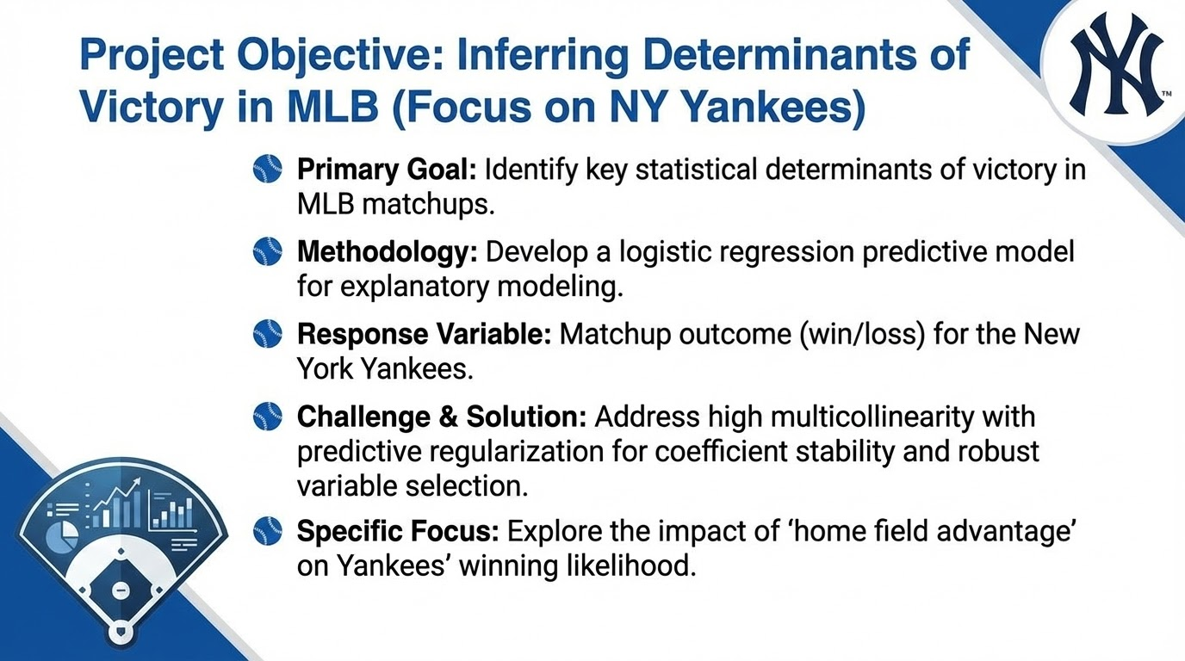

Slide 4
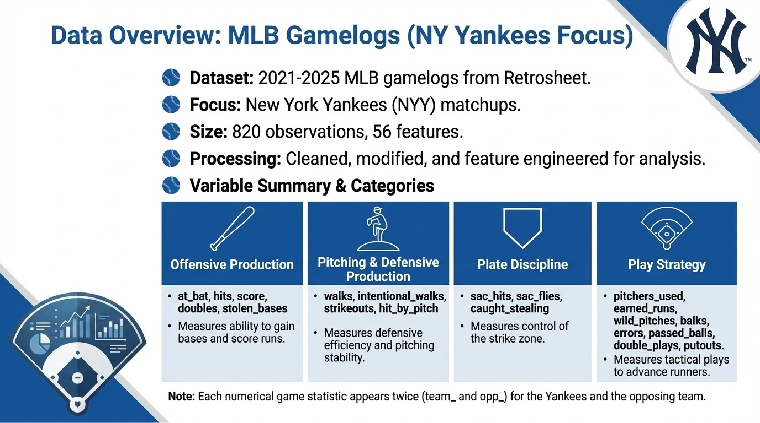

Slide 5
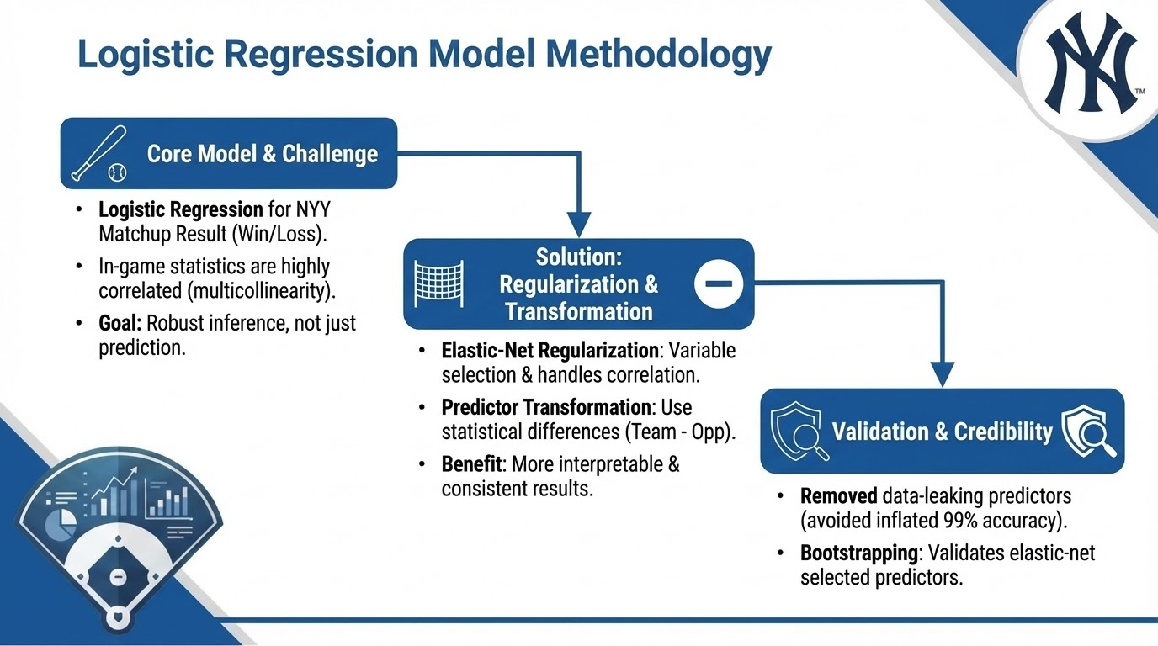

Slide 6
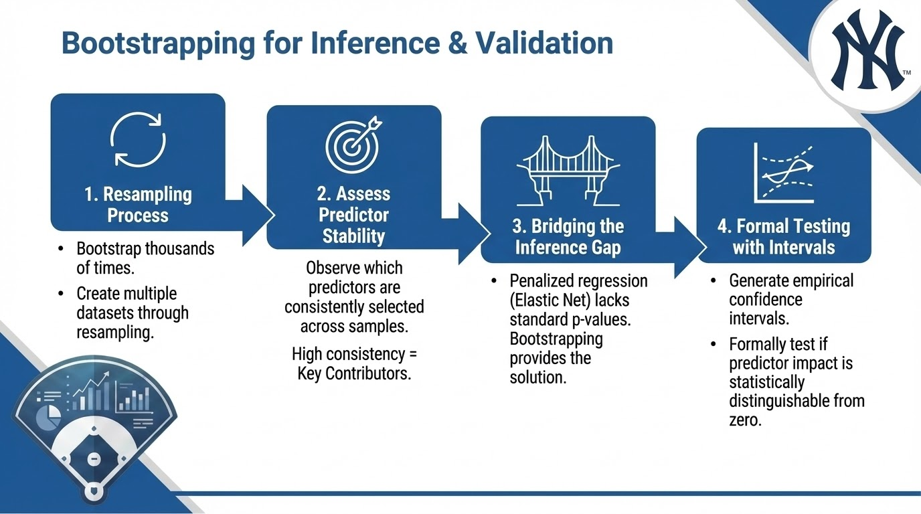

Slide 7
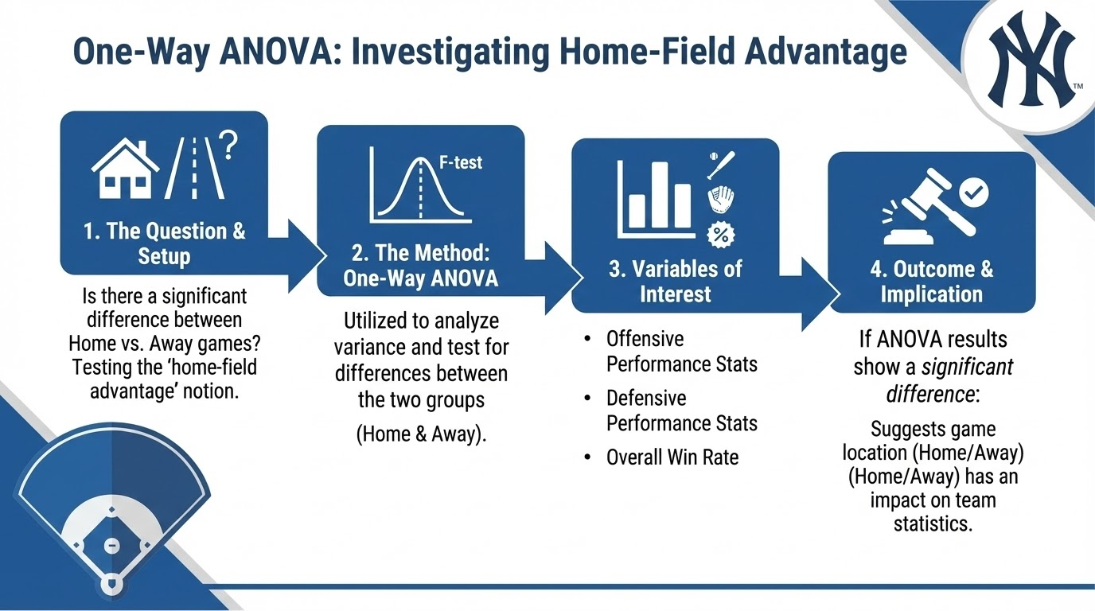

Slide 8
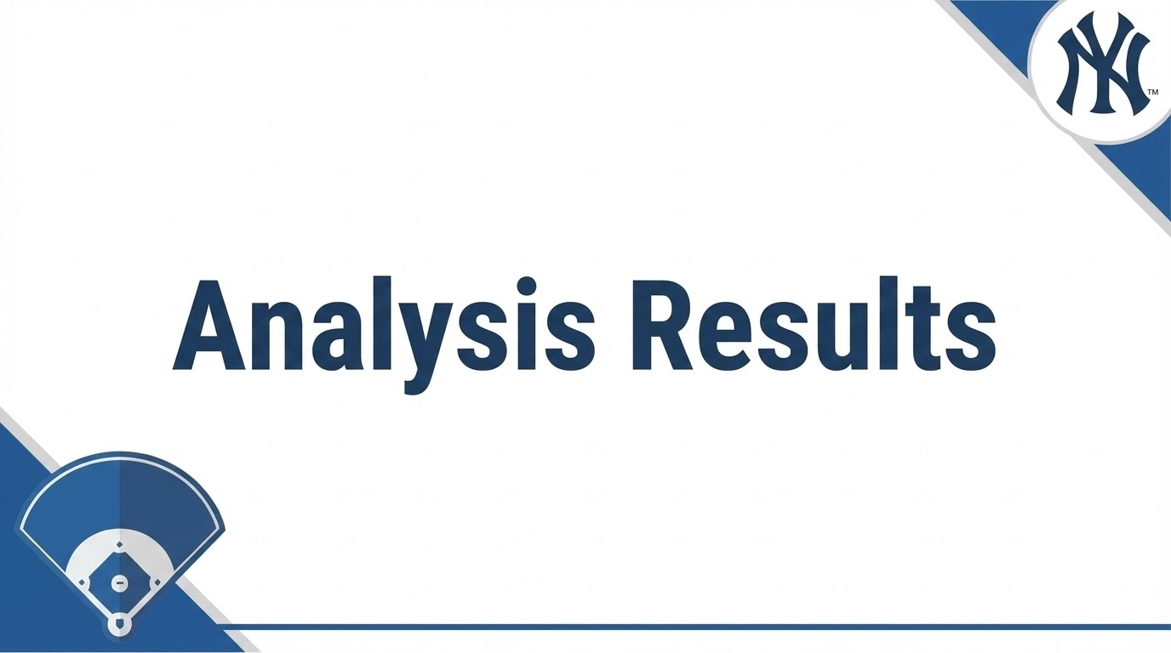

Slide 9
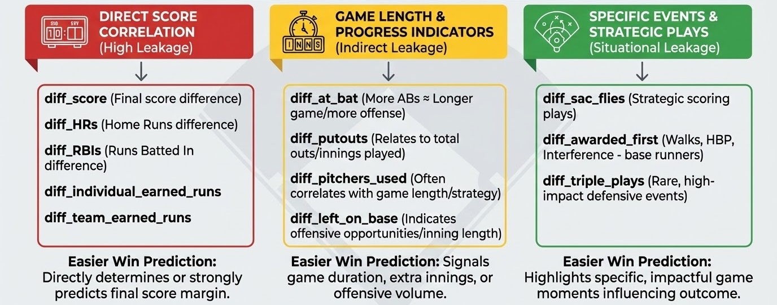
Logistic Regression: Data Leakage

Slide 10
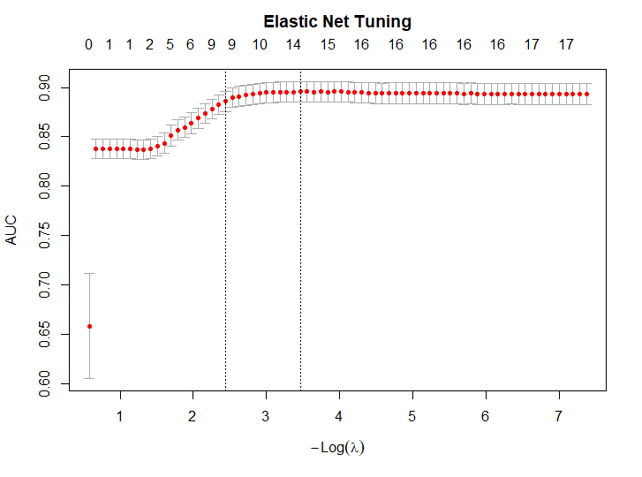
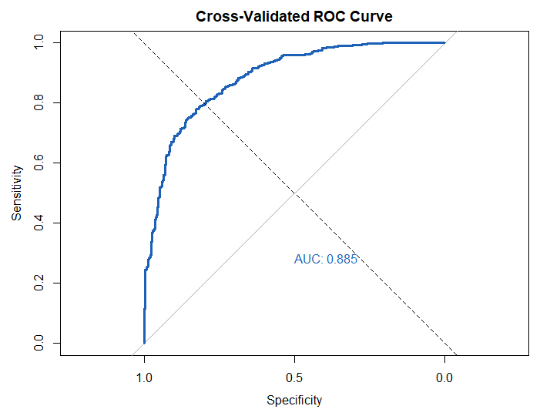
Logistic Regression: Results

Slide 11
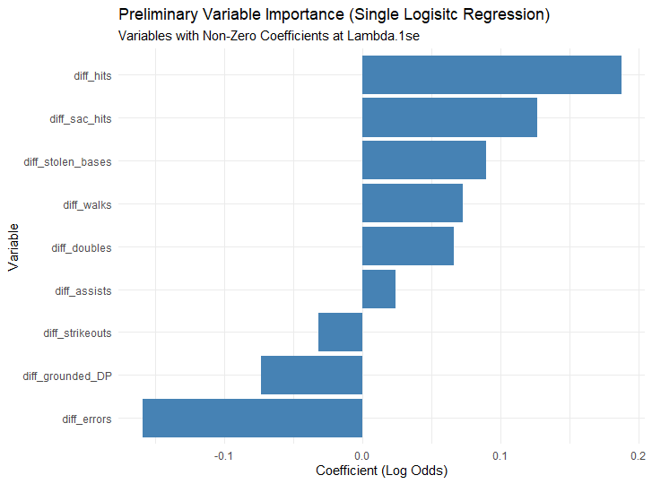
Logistic Regression: Results

Slide 12
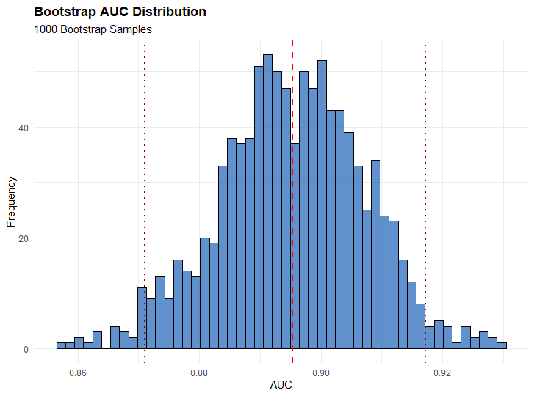
Bootstrapping

Slide 13
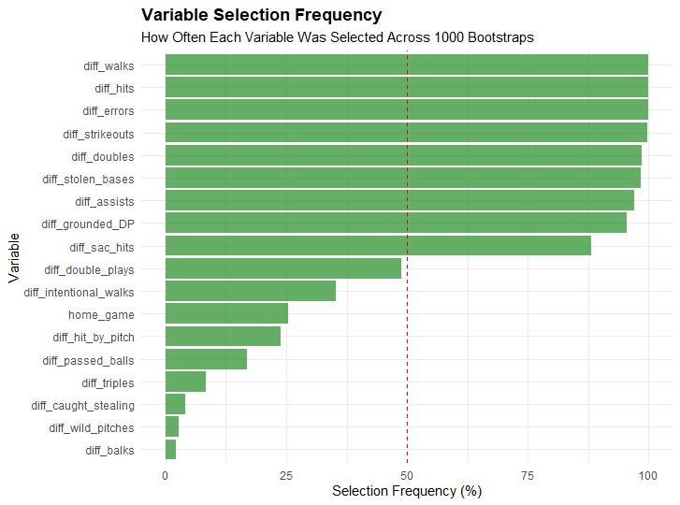
Bootstrapping

Slide 14
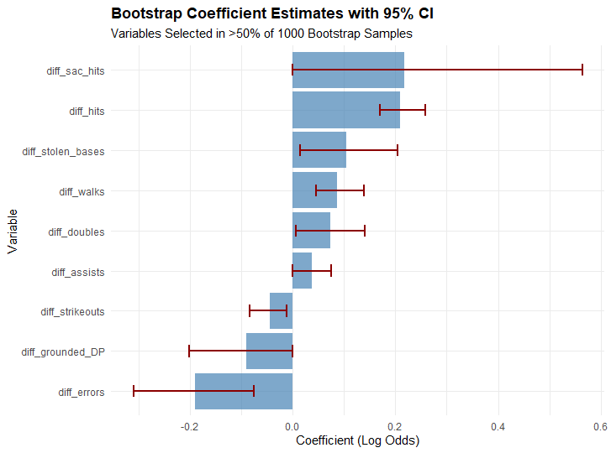
Bootstrapping

Slide 15
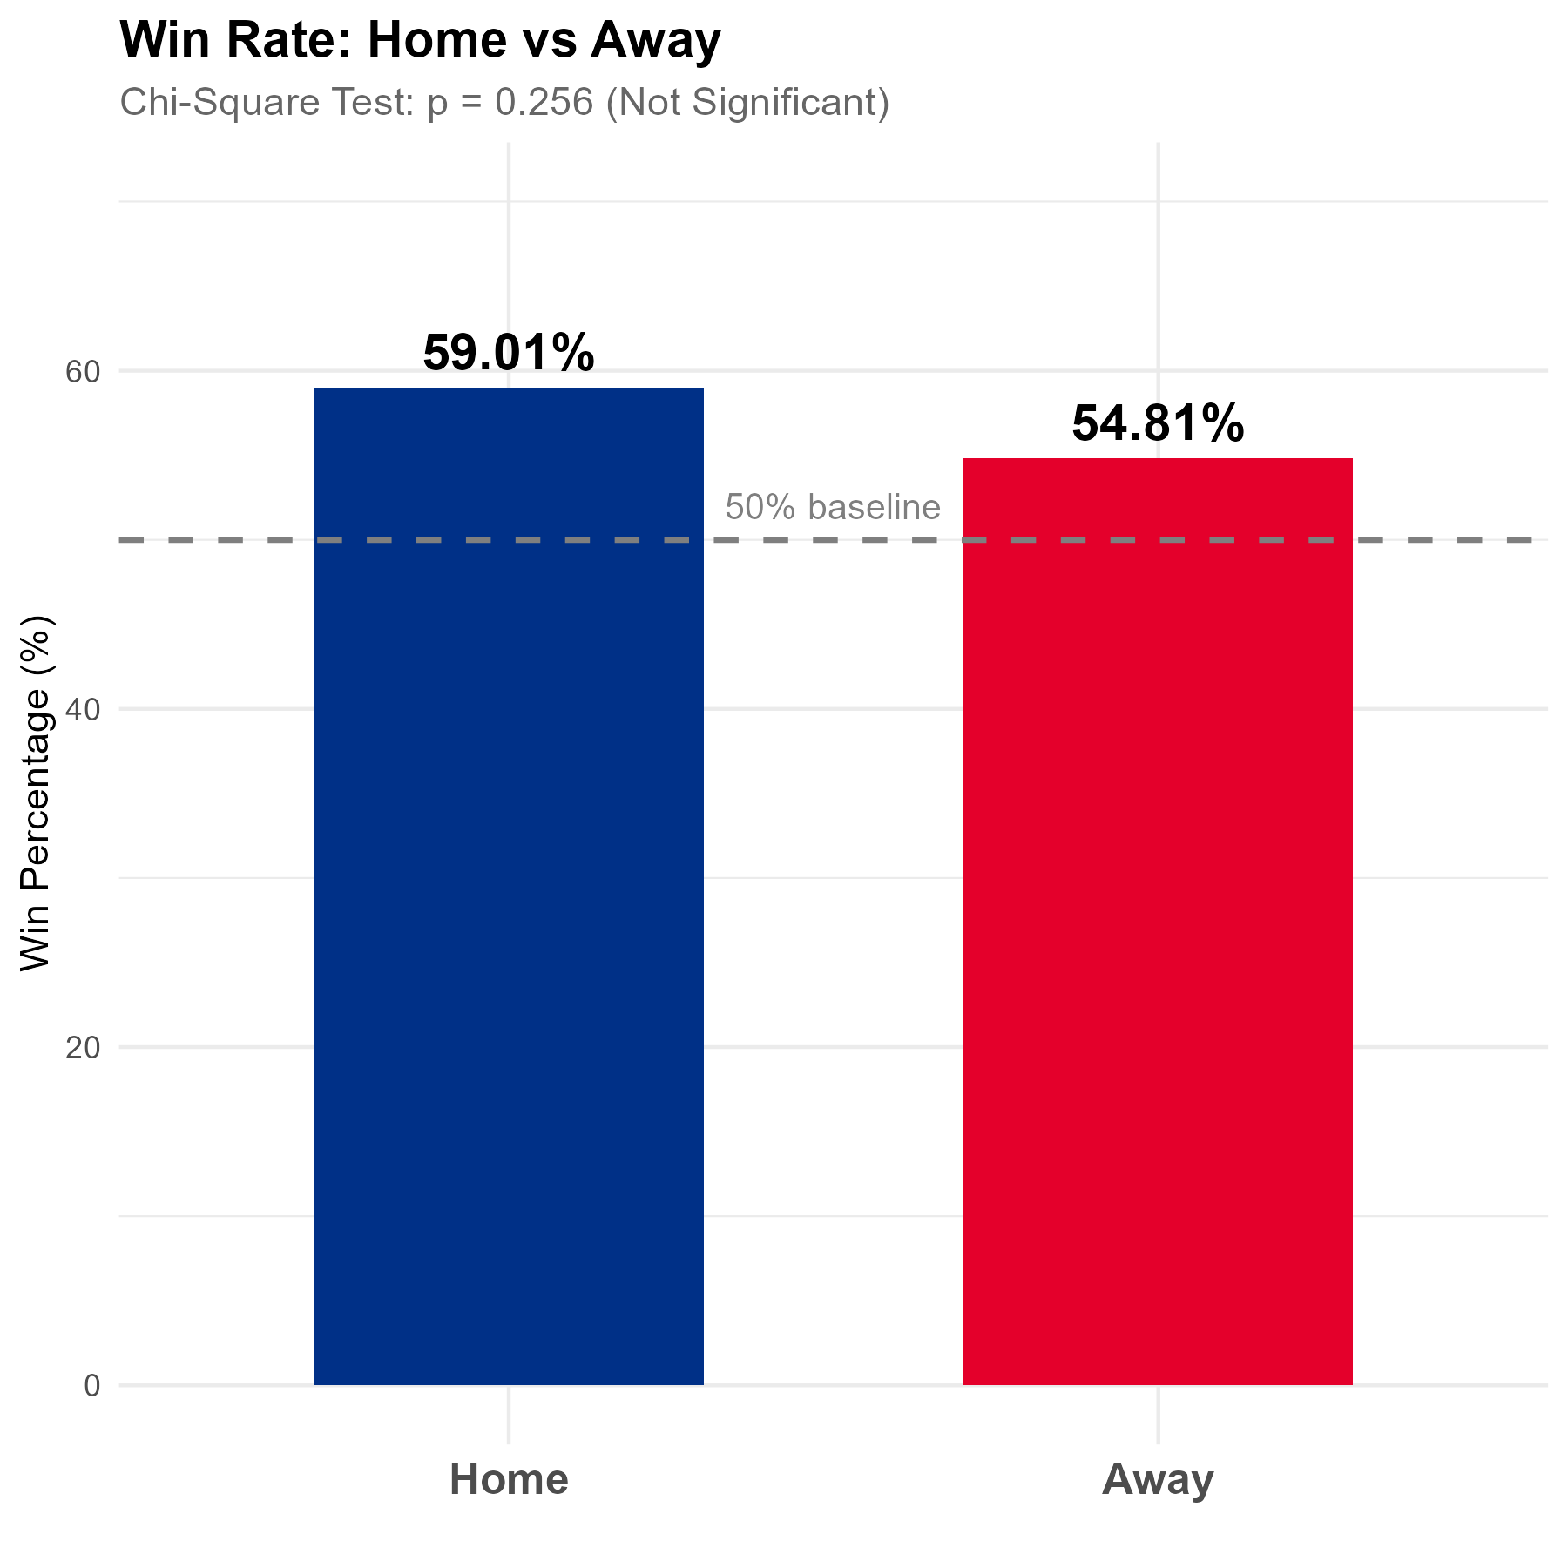
Home Field Advantage: Chi-Square Test
Chi-Square test used for binary outcome (win/loss)
Home win rate: 59.01% vs Away win rate: 54.81%
Test statistic: χ² = 1.289, p-value = 0.256 (NOT statistically significant)
Effect size (Cramer's V): 0.04 (negligible)
Takeaway: These results suggest that playing at home does not significantly increase the Yankees' probability of winning.

Slide 16
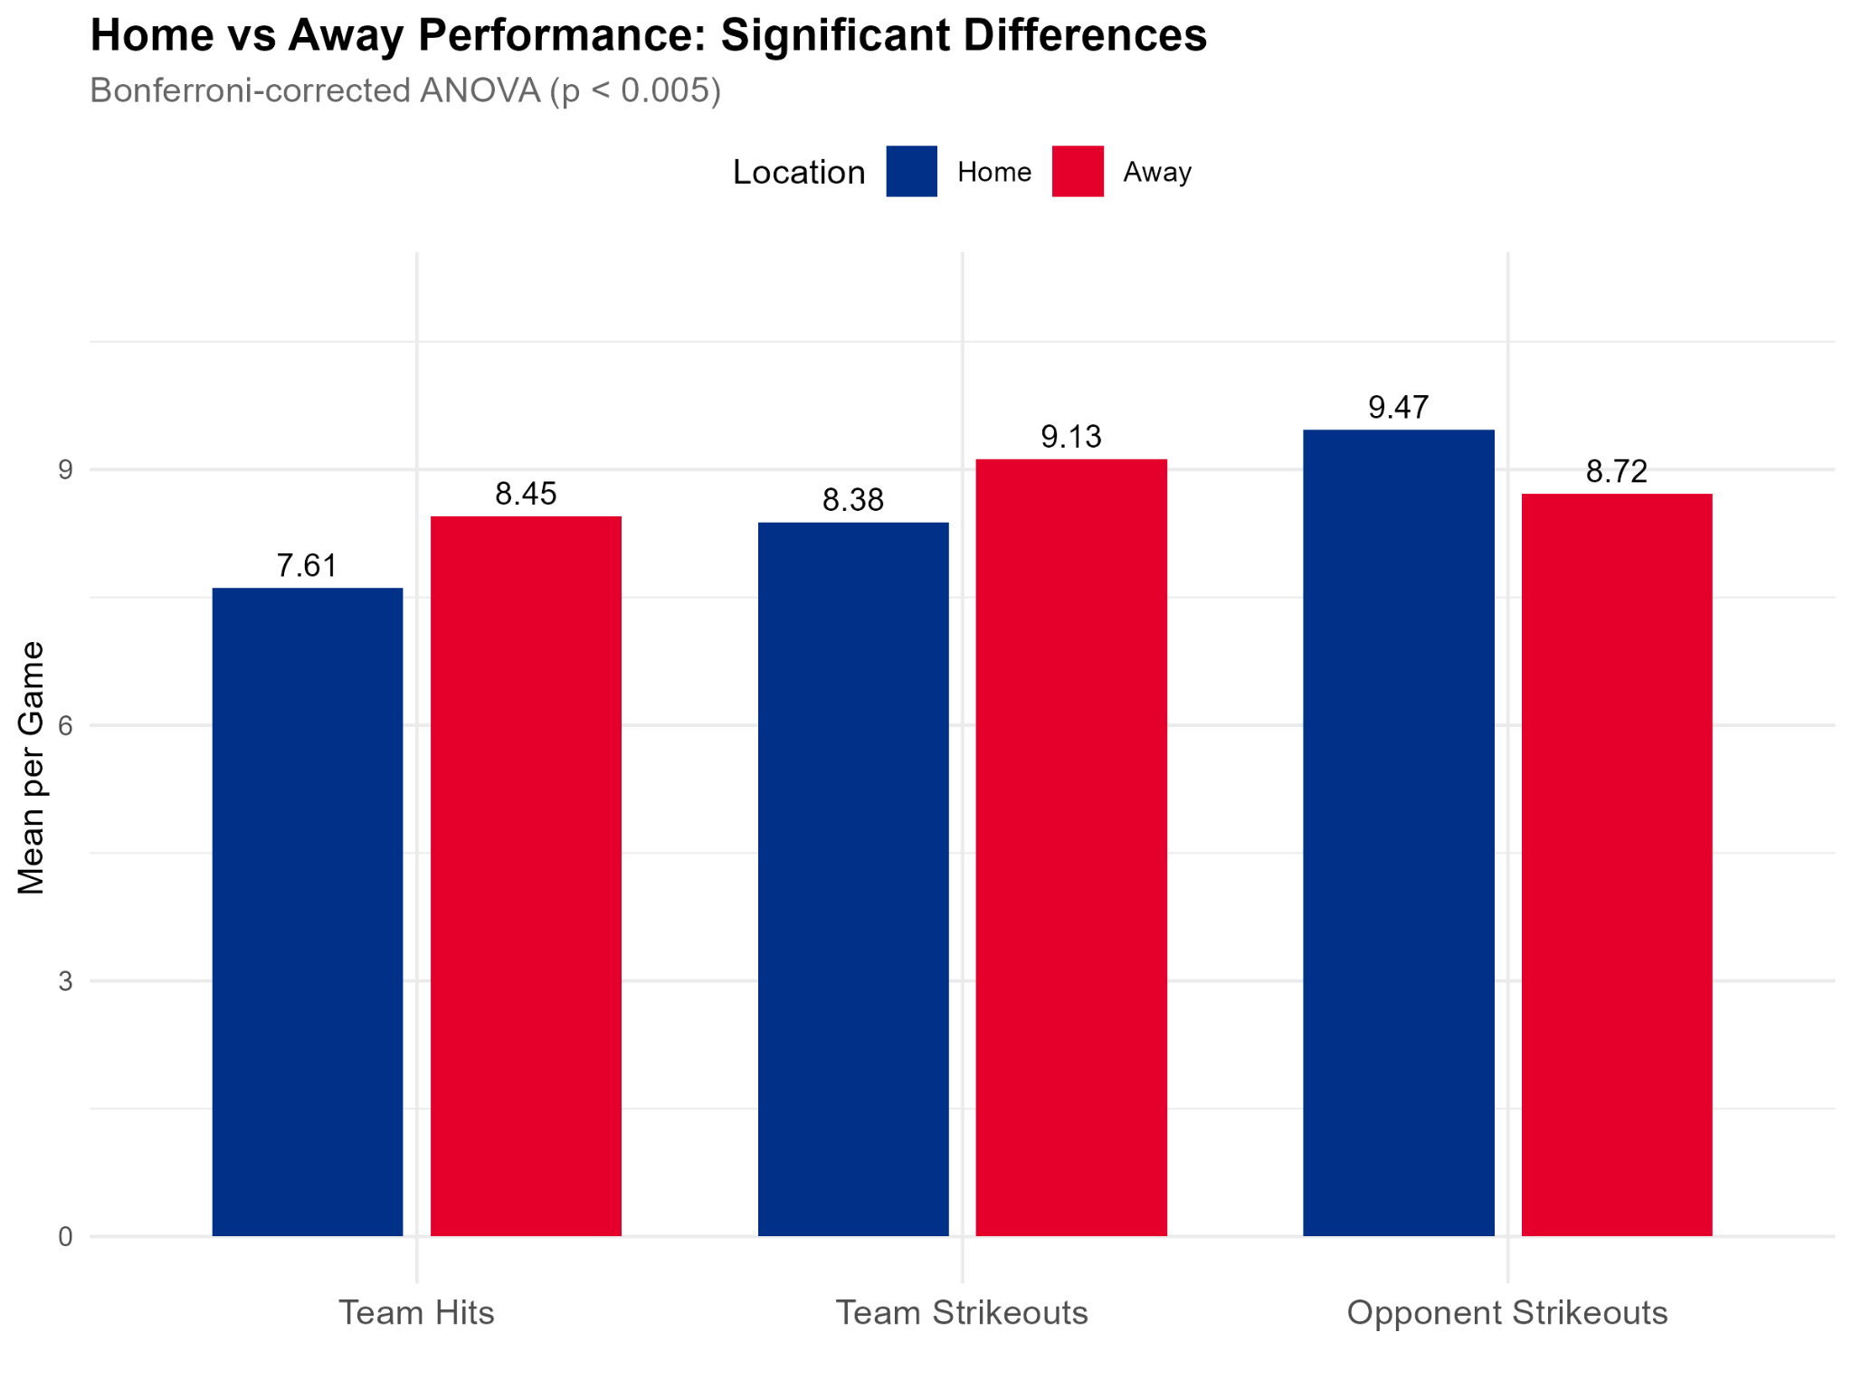
Home Field Advantage: ANOVA Tests
One-way ANOVA tests conducted on 9 chosen continuous performance metrics
Bonferroni correction applied (α = 0.005) to control for multiple comparisons
Only 3 of 9 variables showed significant differences:
  Team Hits: Away (8.45) > Home (7.61)
  Team Strikeouts: Away (9.13) > Home (8.38)
  Opponent Strikeouts: Home (9.47) > Away (8.72)
All effect sizes small (η² < 0.02), explaining less than 2% of variance
Takeaway: Yankees pitchers perform better at home, but the team records more hits and strikes out more away.

Slide 17
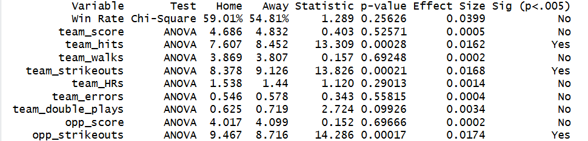
Home Field Advantage: Full Results
Key finding: Win rate and run scoring metrics (team_score, opp_score) show no significant home/away differences
Home field advantage influences specific behaviors, but not game outcomes
Practical implication: Game location should not be weighted heavily when predicting Yankees wins

Slide 18
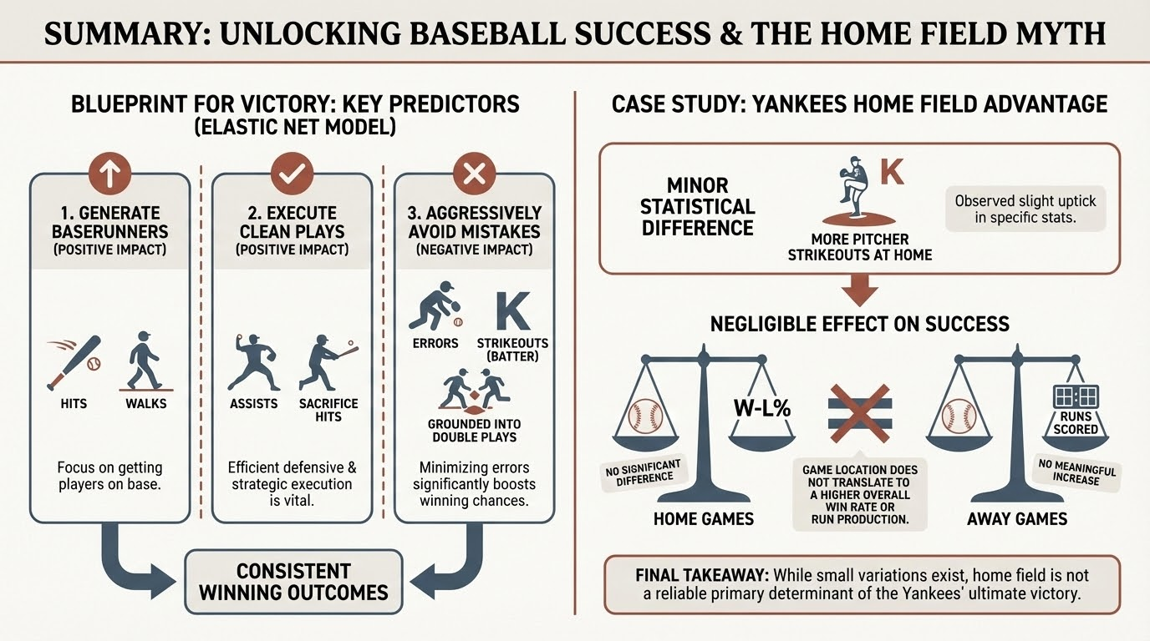

Slide 19
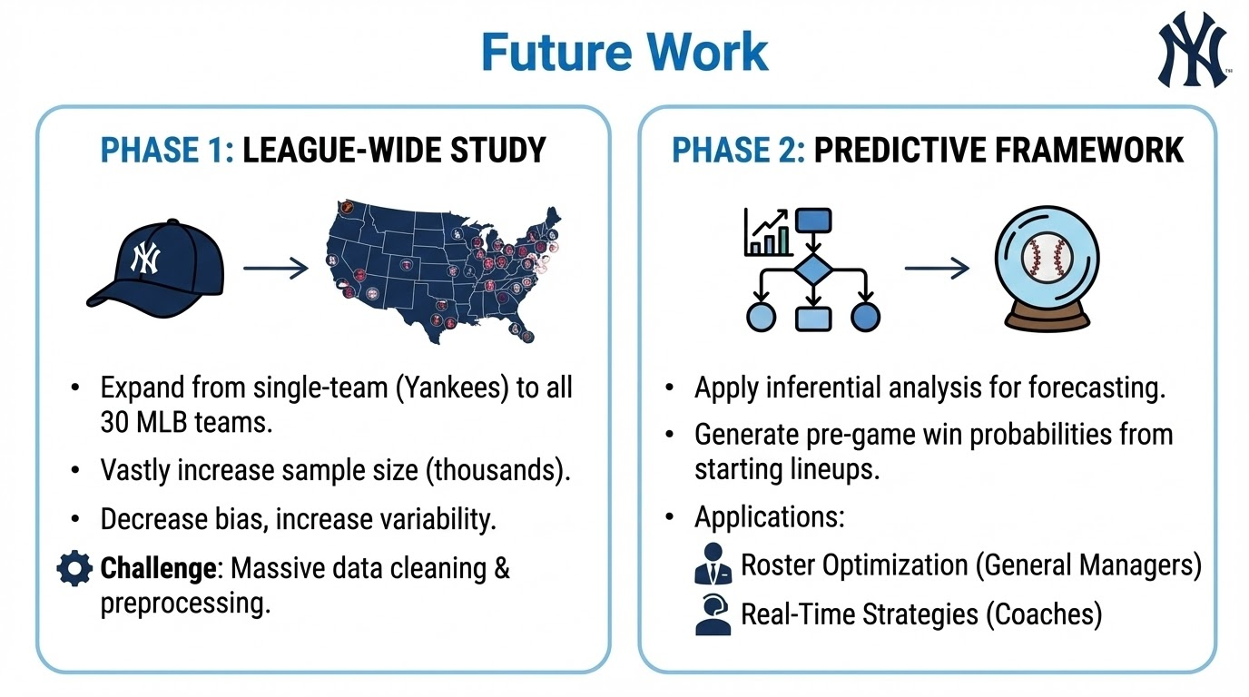

Slide 20
Appendix
Retrosheet. (2025). Game logs and event files [2021-2025]. Retrieved from https://www.retrosheet.org

